Slide 1
Node.js concepts
and
E-commerce web application Demo
Rashad k

Slide 2
Promise object
-Advancement of callbacks in node
-Handle asynchronous operations in javascript
-Improves code readability,better handling of asynchronous operations and better error handling
-Three states,namely-fulfilled ,rejected and pending
-Created using Promise constructor
-Syntax
var promise = new Promise(function(resolve, reject){
//do something
});

Slide 3
Example of Promise object
var promise = new Promise(function(resolve, reject) {
const x = "geeksforgeeks";
const y = "geeksforgeeks"
if(x === y) {
resolve();
} else {
reject();
}
});
promise.
then(function () {
console.log('Success, You are a GEEK');
}).
catch(function () {
console.log('Some error has occured');
});

Slide 4
Express Framework,Express Generator and Handlebars
-Express is back end web application framework for Node.js
-Express generator is an npm module that quickly creates an application skeleton.
-Handlebars ,the templating engines used in server side.
-A templating engine takes a bunch of static HTML files, fills them with the necessary data on the server side then sends them as any ordinary HTML file to the client.

Slide 5
Ajax and MongoDB CRUD operations
-Ajax stands for asynchronous javascript and XML
-Ajax is a web technique to make changes in particular parts of a displayed web page .
-MongoDB is a NoSQL database program and uses JSON like documents.
-In mongoDB,’collection’ is analogous to table in SQL databases and ‘document’ is analogous to record in SQL databases.

Slide 6
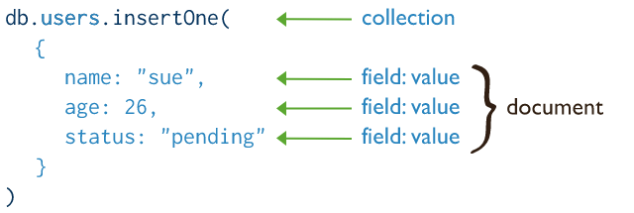
Ajax and MongoDB CRUD operations
-A mondoDB database is created using ‘use command’.
Eg:use shopping
-insert operations add new documents to a collection. If the collection does not currently exist, insert operations will create the collection.
eg:

Slide 7
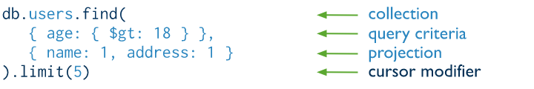
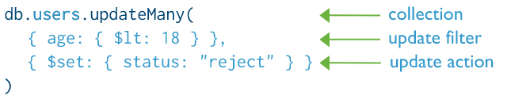
Ajax and MongoDB CRUD operations
-Read operations retrieve documents from a collection.
Eg:
-Update operations modify existing documents in a collection. eg:

Slide 8
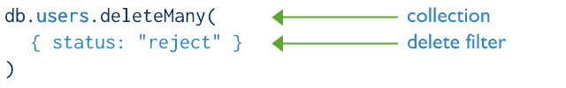
Ajax and MongoDB CRUD operations
-Delete operations remove documents from a collection.
Eg :

Slide 9
DEMO
GIT Link:E-commerce applciation

Slide 10
THANK YOU

